Slide 2
RAVELLA ABHINAV
CB.EN.U4CSE19453

Slide 3
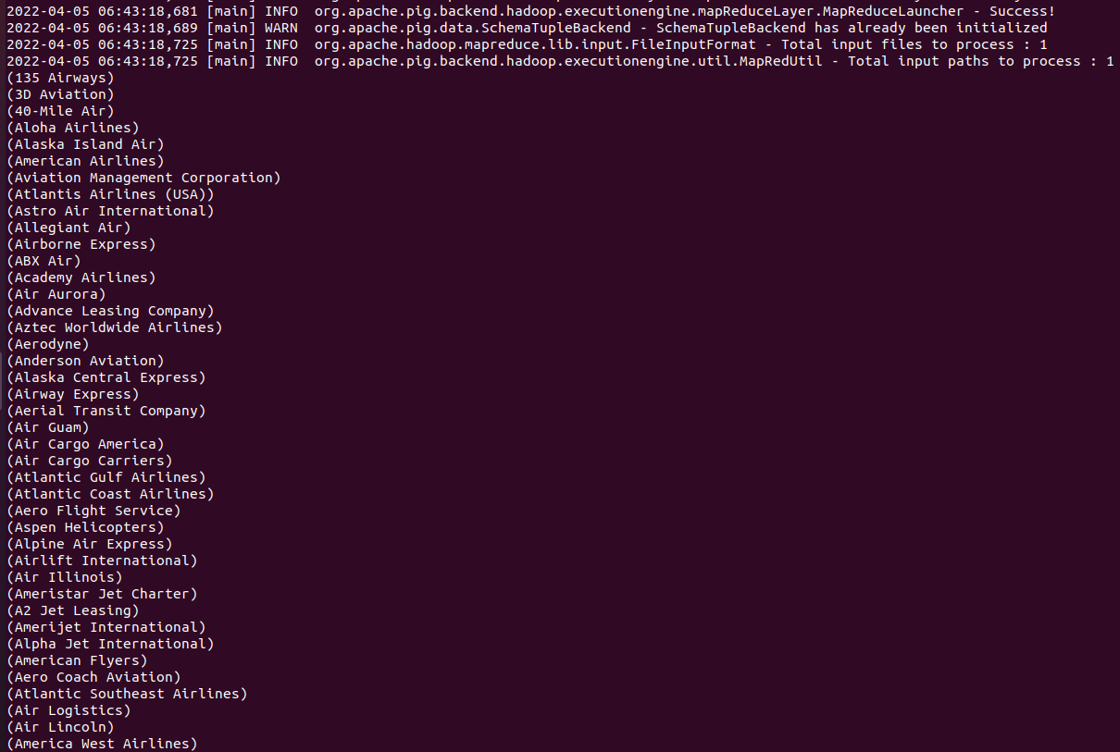
1. Find the names of active airlines in territory ‘Unites States’?
Query:
active_airlines = filter finalair by active == 'Y';
active_airlines_usa = filter active_airlines by territory == 'United States';
find_active_airline_names_in_usa = foreach active_airlines_usa generate airline_name;
dump find_active_airline_names_in_usa;

Slide 4
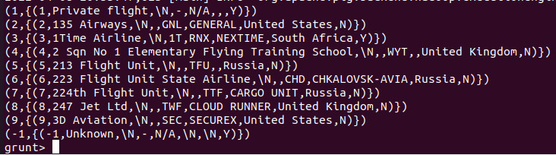
2. Group airline id by active status;
Query:
ae = group finalair by airlineID;
ans = limit ae 10;
illustrate as;
dump as;

Slide 5
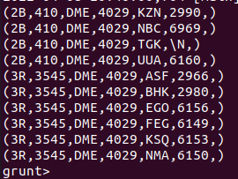
3. Split relation based on src airport id i.e, equal to DME to get exclusive info.
Query:
split routes into ru_dme if route_source_iata == 'DME' , ru_not_dme if route_source_iata != 'DME';
dump ru_dme;
dump ru_not_dme;

Slide 6
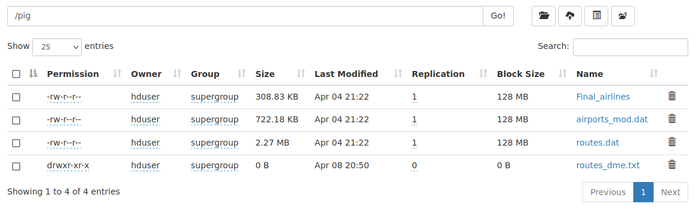
4. Store ru_dme relation into text file separated by delimiter “,”.
Query:
store ru_dme into '/pig/routes_dme.txt' using PigStorage(',’);
Output:

Slide 7
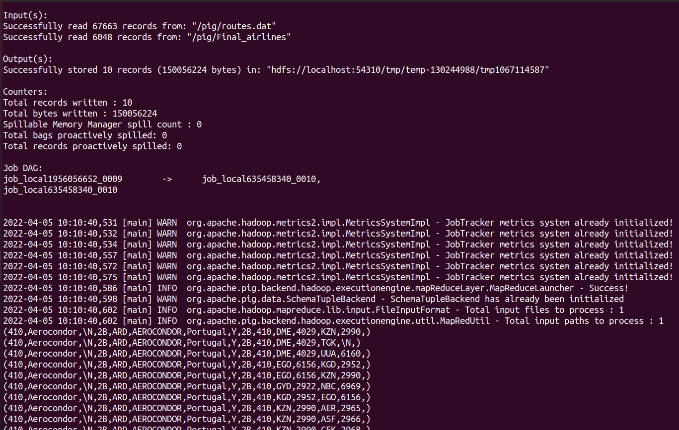
5. JOIN Command:
Query:
right_join = JOIN finalair BY airline_iata RIGHT OUTER, routes BY route_iata;
LIM = LIMIT right_join 10;
dump LIM;
Output:

Slide 8
S SHANTHAN REDDY
CB.EN.U4CSE19459

Slide 9
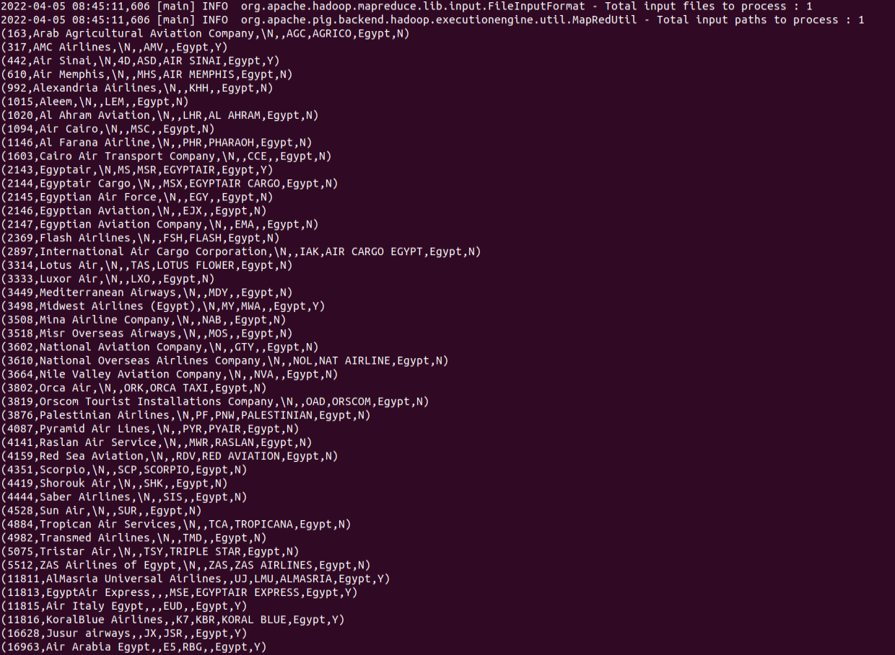
egyt = filter finalair by territory == 'Egypt'; dump egyt;

Slide 10
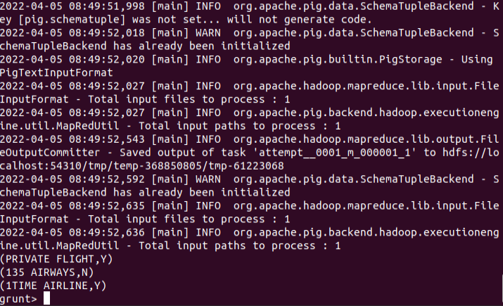
2. up = foreach finalair generate UPPER(airline_name),active; a = limit up 3; dump a;

Slide 11
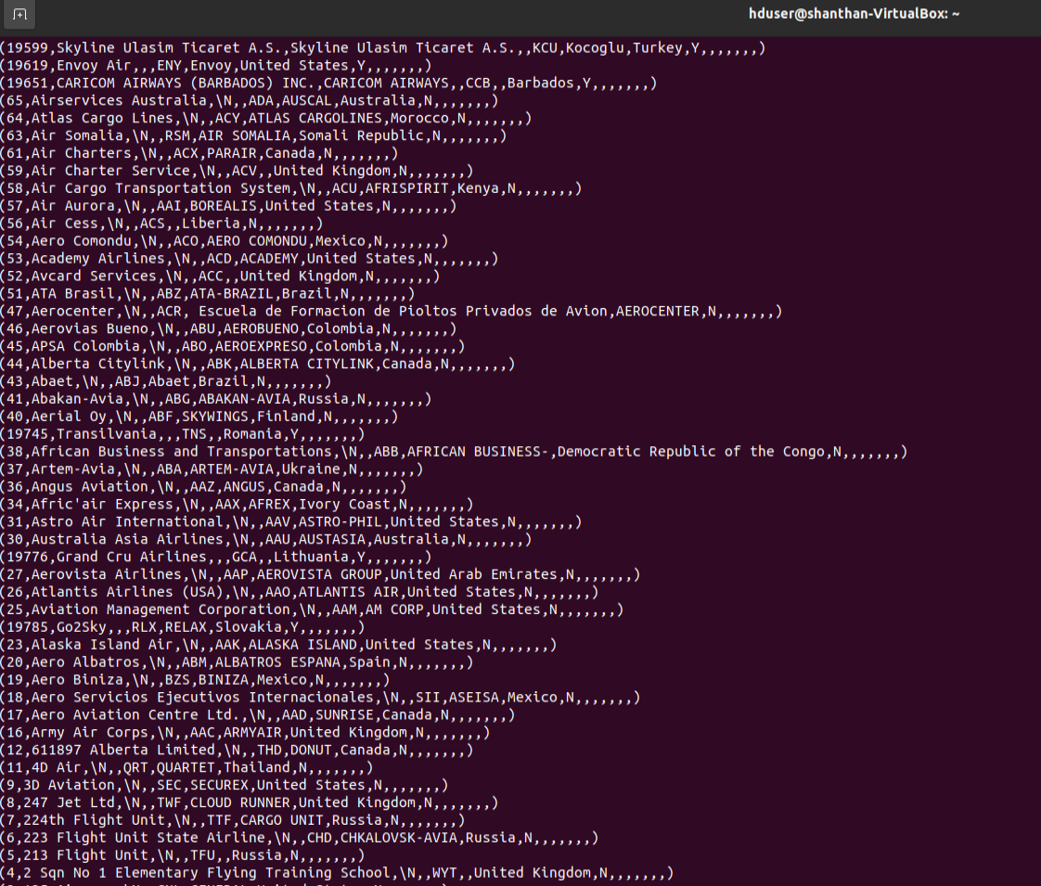
3. outer_left = JOIN finalair BY airline_iata LEFT OUTER, routes BY route_iata; dump outer_left;

Slide 12
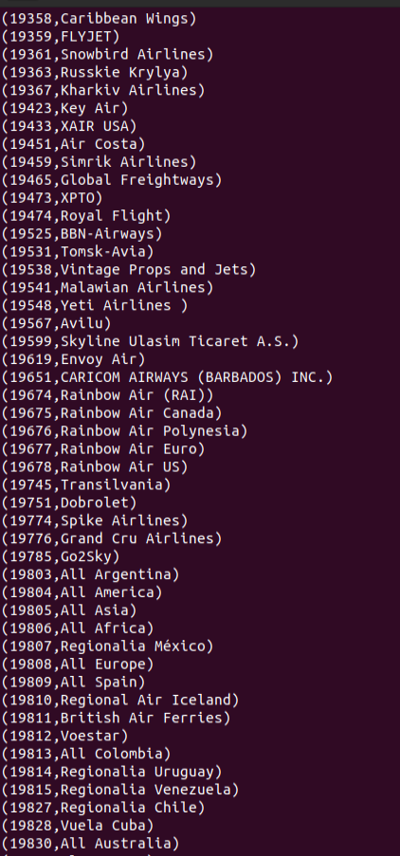
4. order_data = ORDER finalair by airlineID DESC; Disp=FOREACH finalair GENERATE airlineID,airline_name; Dump disp;

Slide 13
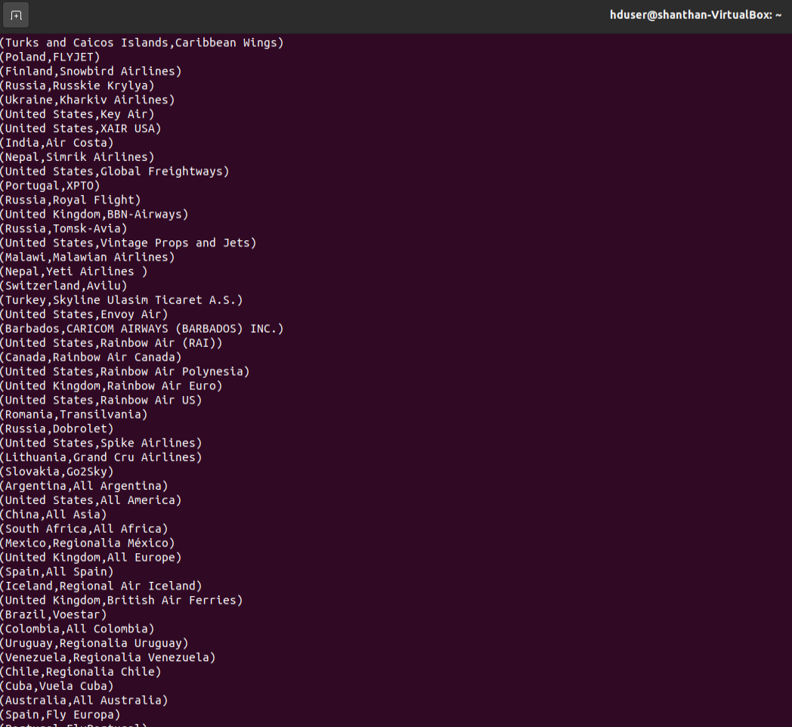
5. group_data = GROUP finalair by territory; display = FOREACH finalair GENERATE territory,airline_name; Dump display;

